Slide 1
ER Model – Types/ SubTypes

Slide 2
Supertypes and Subtypes
Supertype: An generic entity type that has a relationship with one or more subtypes
Subtype: A subgrouping of the entities in an entity type which has attributes that are distinct from those in other subgroupings
Attribute Inheritance:
  Subtype entities inherit values of all attributes of the supertype
  An instance of a subtype is also an instance of the supertype
Sounds like object-oriented?
Dr. Ejaz Ahmed

Slide 3
Subtype Entities
A subtype entity is a special case of another entity called its supertype.
Subtypes can be exclusive or inclusive.
  If exclusive, the supertype relates to at most one subtype.
  If inclusive, the supertype can relate to one or more subtypes.
Dr. Ejaz Ahmed

Slide 4
Subtype Entity Identifiers
The relationships that connect supertypes and subtypes are called IS-A relationships because a subtype is the same entity as the supertype
The identifier/primary key of a supertype and all of its subtypes is the same attribute
Dr. Ejaz Ahmed

Slide 5
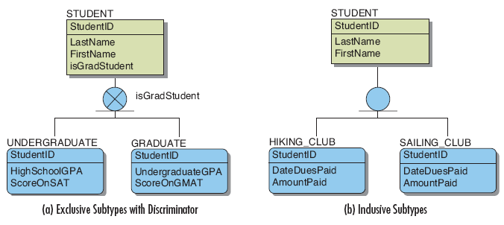
Subtype Entity Examples
Dr. Ejaz Ahmed

Slide 6
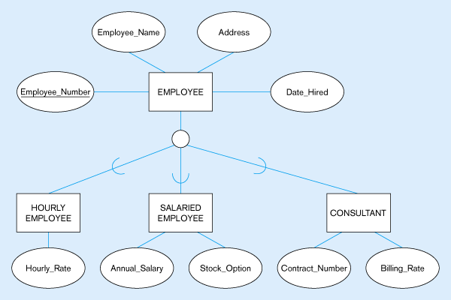
All employee subtypes will have employee number, name, address, and date-hired
Each employee subtype will also have its own attributes
Dr. Ejaz Ahmed
Figure 4-2 – Employee supertype with three subtypes
Notes:
Need additional columns, No of Hours, Bonus, Deduction, Tax, Pension etc.

Slide 7
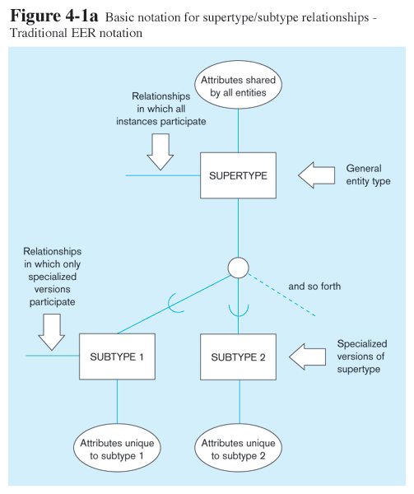
Dr. Ejaz Ahmed

Slide 8
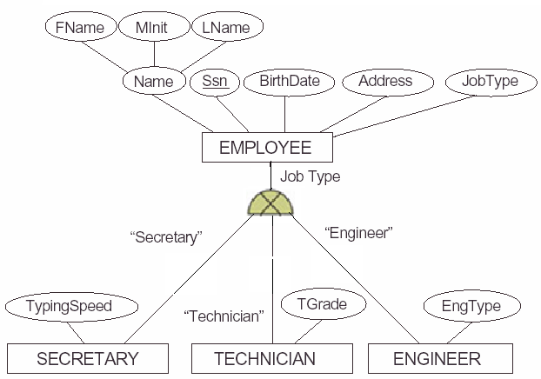
Disjoint Exclusive Relationship Mapping
ER Model
Relational Schema/
Table Design
SSN
Fname
Minit
Lname
Bdate
Address
Jobtype
SECRETARY
TECHNICIAN
ENGINEER
SSN
TypingSpeed
SSN
TGrade
SSN
EngType
Dr. Ejaz Ahmed
5-<number>
Notes:
Need additional column short-hand for secretary. This is called Specialization

Slide 9
Disjoint Exclusive Relationship Mapping
FName
LName
DOB
Mobile#
Lib. Member
StuID
EmpNo
type
Student
Employee/ Staff
ER Model
Relational Schema/ Table Design
LibMember
CardID FName LName DOB Mobile# MemberType
Note: Any two entities which have same attributes domains can be mapped together into one table. This requires an additional attribute to identify types.
Examples: A STUDENT has a DegreeType either UG, Master or PhD. A PERSON has a NationalityType either Citizen or Foreigner
Dr. Ejaz Ahmed
Notes:
Issuance of books, return policy can be managed

Slide 10
Inclusive Relationship Mapping
In a hospital all employees such as doctors, nurses and other medical staff are the patient as well. Then draw their subtype ER.
Dr. Ejaz Ahmed

Slide 11
Generalization and Specialization
Generalization: The process of defining a more general entity type from a set of more specialized entity types. BOTTOM-UP. Generalizing Entities
Specialization: The process of defining one or more subtypes of the supertype, and forming supertype/subtype relationships. TOP-DOWN
Dr. Ejaz Ahmed

Slide 12
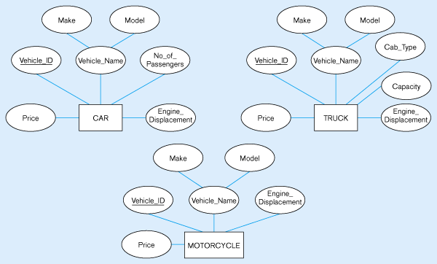
Example of generalization
Notice anything?
All these types of vehicles have common attributes
Motorcycle cannot
Be generize with
car and truck

Slide 13
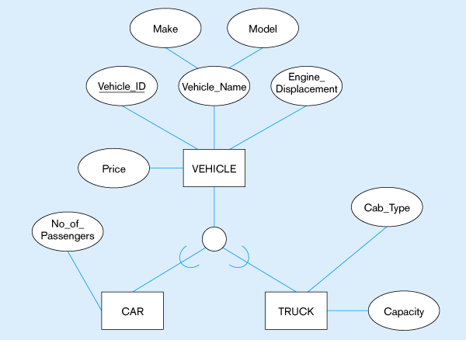
So we put the shared attributes in a supertype
Note: no subtype for motorcycle, since it has no unique attributes
Dr. Ejaz Ahmed
Generalization to VEHICLE supertype

Slide 14
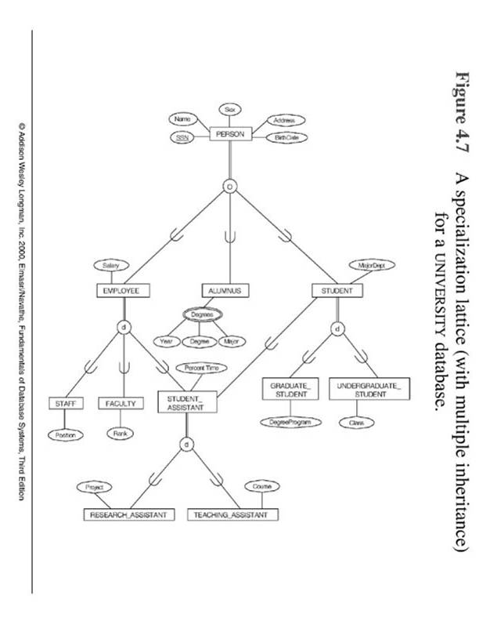
- Specialization & Lattice
Dr. Ejaz Ahmed

Slide 15
- Categorization
Categorization (Union) is the modeling of a single subclass (called a category) with a relationship that involves more than one distinct superclasses. (see this Figure)
The difference between category and a shared subclass is that a shared subclass entity must be a member of all the superclass entities (intersection) whereas a category is a subset of the union of its superclasses. Hence an entity which is a member of a category must exist in only one of the superclasses.
In a category, subclass has selective inheritance.
Categories can be either total or partial.
  Total: every occurrence of all superclass must appear in the category.
  Partial: Some occurrences of all superclasses may not appear in the category.
Dr. Ejaz Ahmed

Slide 16
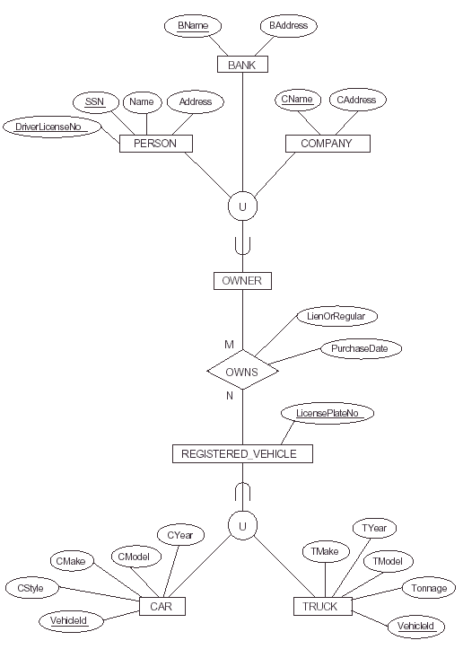
Dr. Ejaz Ahmed
Notes:
A person can buy vehicle to become an owner, a person and bank both can be owners of a vehicle. Company alone become owner and joint with Bank can be owner. Purchased vehicles will be registered with overlap link as CAR or TRUCK (Mini or big trucks)

Slide 17
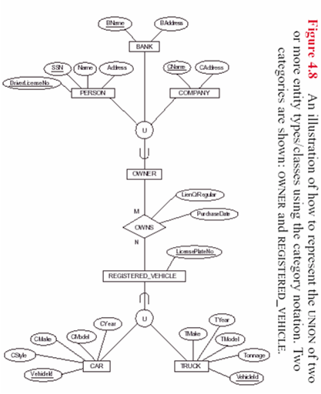
-- Example: Categorization
Dr. Ejaz Ahmed

Slide 18
Constraints in Supertype/ Completeness Constraint
Completeness Constraints: Whether an instance of a supertype must also be a member of at least one subtype
  Total Specialization Rule: Yes (double line)
  Partial Specialization Rule: No (single line)
Dr. Ejaz Ahmed

Slide 19
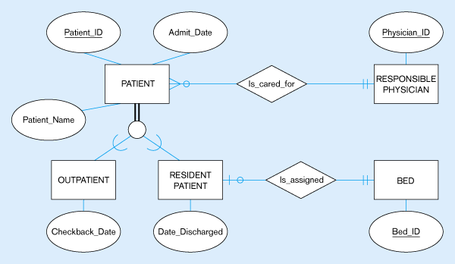
Examples of completeness constraints
Total specialization rule
A patient must be either an outpatient or a resident patient
Dr. Ejaz Ahmed

Slide 20
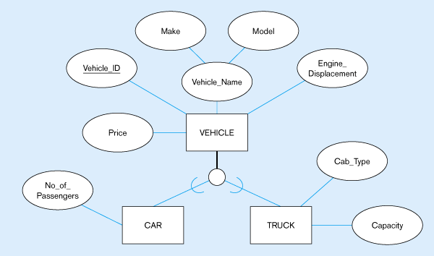
Partial specialization rule
A vehicle could be a car, a truck, or neither
Dr. Ejaz Ahmed

Slide 21
Constraints in Supertype/ Disjointness constraint
Disjointness Constraints: Whether an instance of a supertype may simultaneously be a member of two (or more) subtypes
  Disjoint Rule: An instance of the supertype can be only ONE of the subtypes
  Overlap Rule: An instance of the supertype could be more than one of the subtypes
Dr. Ejaz Ahmed

Slide 22
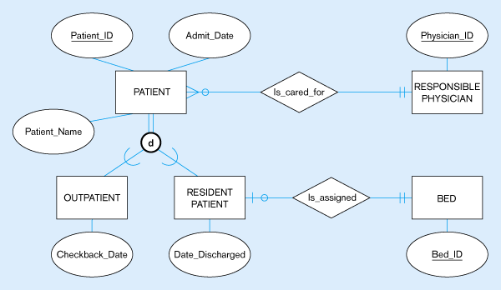
Examples of disjointness constraints
Disjoint rule
A patient can either be outpatient or resident, but not both
Dr. Ejaz Ahmed

Slide 23
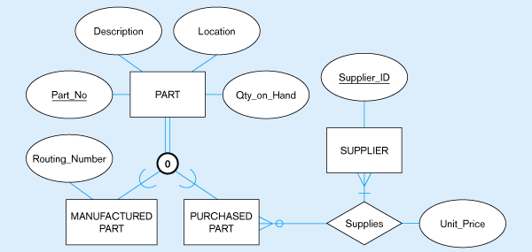
Overlap rule
A part may be both purchased and manufactured
Dr. Ejaz Ahmed
Notes:
Manufactured parts (Routing number, Mprice, MDate, MQTY)
Purchased parts(Pprice, PQTY, SupInvNo)

Slide 24
--- Example: Category Mapping
SSN
PERSON
Name
BANK
Address
COMPANY
Name
Name
License
Address
Address
U
U
OWNER
EER
REL.
PERSON
SSN
License
Name
Address
OwnerId
BANK
BName
BAddress
OwnerId
COMPANY
CName
CAddress
OwnerId
OWNER
OwnerId
Dr. Ejaz Ahmed

Slide 25
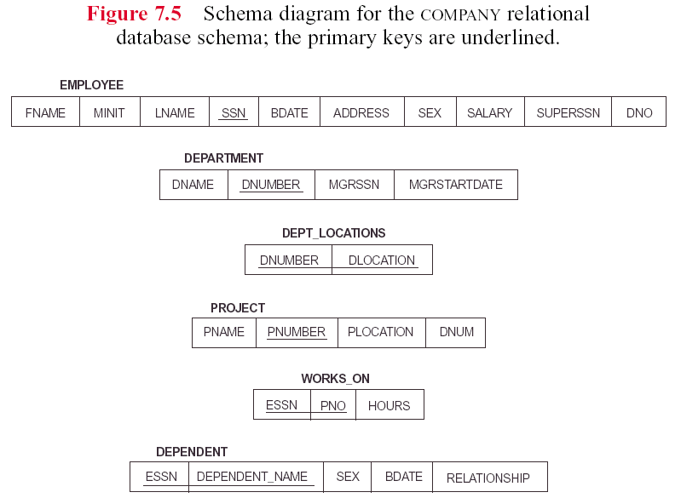
Dr. Ejaz Ahmed

Slide 26
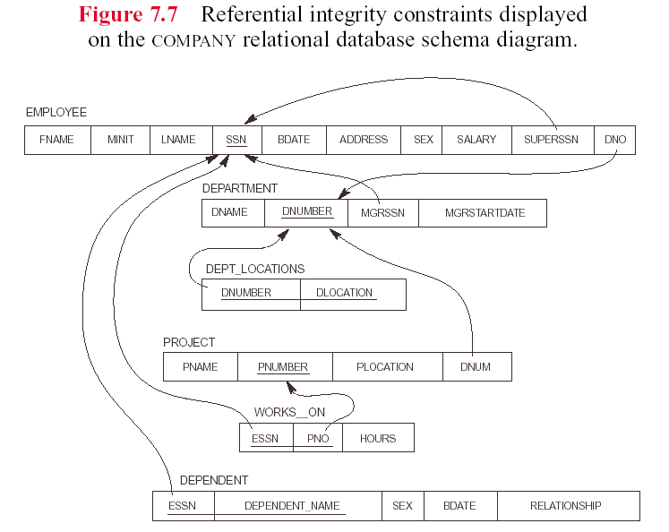
Dr. Ejaz Ahmed

Slide 27
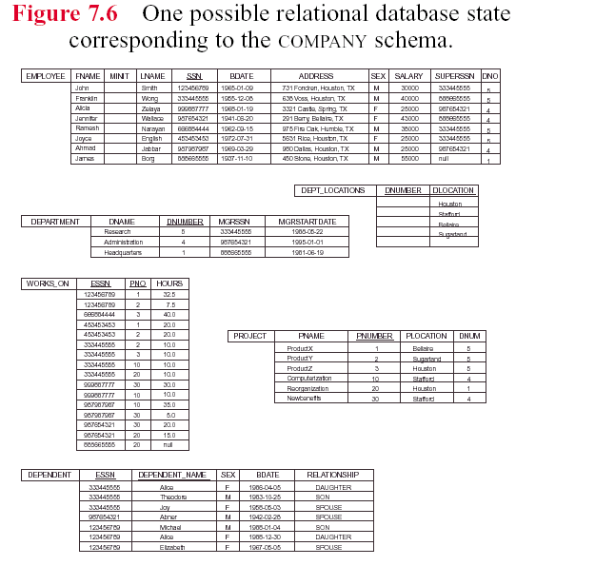
Dr. Ejaz Ahmed

